Slide 1
Longest Common Subsequence

Slide 2
Longest Common Subsequence
Consider a string of characters: X = ABCBDAB.
A subsequence is obtained by deleting some (any) characters of X.
E.g. ABBB is a subsequence of X, as is ABD.
But AABB is not a subsequence.
Let X = (x1, x2, . . . , xm) be a sequence.
Z = (z1, z2, . . . , zk) is subseq. of X if there is an index sequence (i1, . . . , ik) s.t. zj = xij, for j = 1, . . . , k.
Index sequence for ABBB is (1, 2, 4, 7).

Slide 3
Longest Common Subsequence
Given two sequences X and Y , ﬁnd their longest common subsequence.
If X = (A,B,C,B,D,A,B) and Y = (B,D,C,A,B,A), then (B,C,A) is a common sequence, but not LCS.
(B,D,A,B) is a LCS.
How do we ﬁnd an LCS?
Can some form of Greedy work? Suggestions?

Slide 4
Trial Ideas
Greedy-1:
Scan X. Find the ﬁrst letter matching y1; take it and continue.
Problem: only matches preﬁx substrings of Y .
Greedy-2:
Find the most frequent letters of X; or sort the letters by their frequency. Try to match in frequency order.
Problem: Frequency can be irrelevant. E.g. suppose all letters of X are distinct.

Slide 5
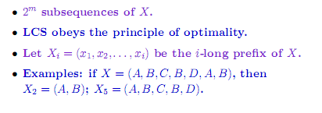
Properties

